Slide 1
WebGL / Graphics 스터디
Day 4
Threejs : Texture, Light, Camera, glTF

Slide 2
What we did, what we should
We are able to…
Create basic objects + move them around
Create basic camera
Very basic animation
We need to…
Load complex objects
Use textures
Load complex animation
Move camera around + create compositions

Slide 3
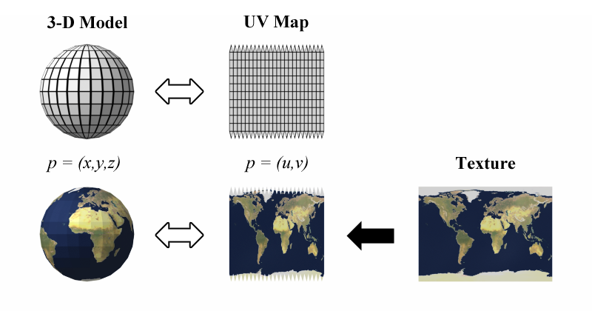
Texture
What is texture mapping?

Slide 4
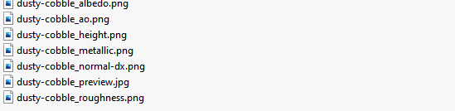
More than just color.
https://freepbr.com/materials/dusty-cobble-pbr/
What does pbr-texture consist of?

Slide 5
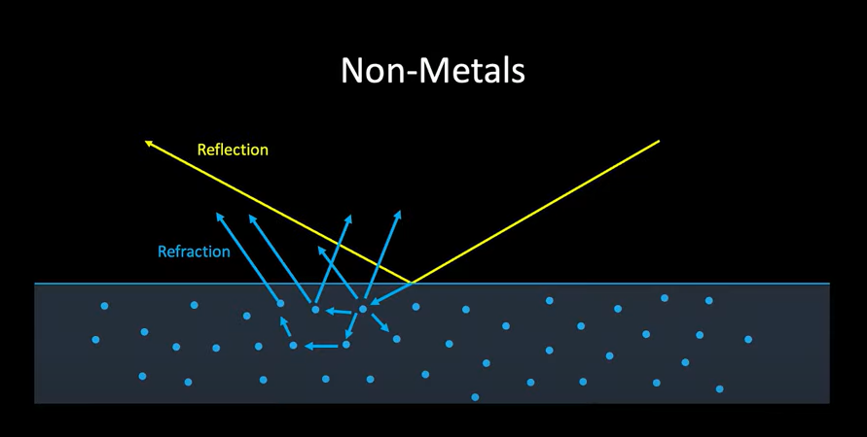
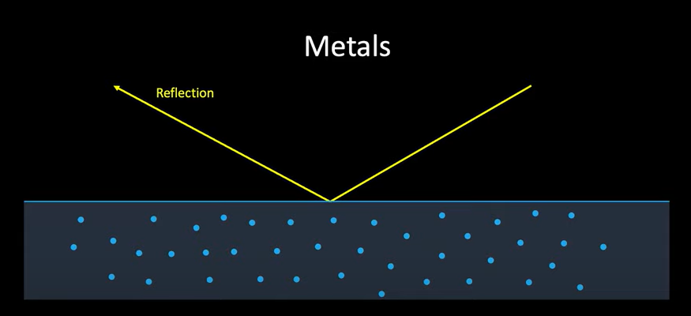
PBR

Slide 6
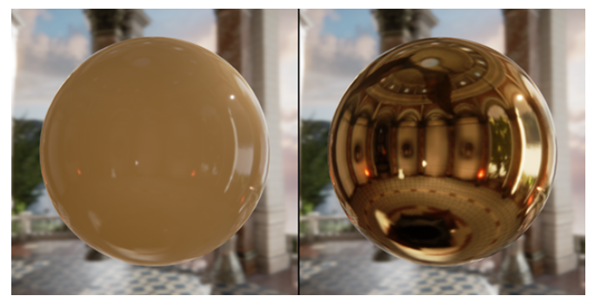
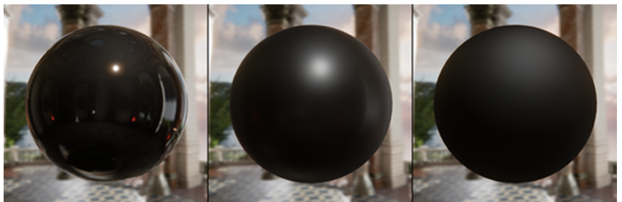
Roughness, Metallic, Albedo
얼마나 빛 자체를 반사하는가?
얼마나 반사가 선명한가?
원래 색은 무엇인가?

Slide 7
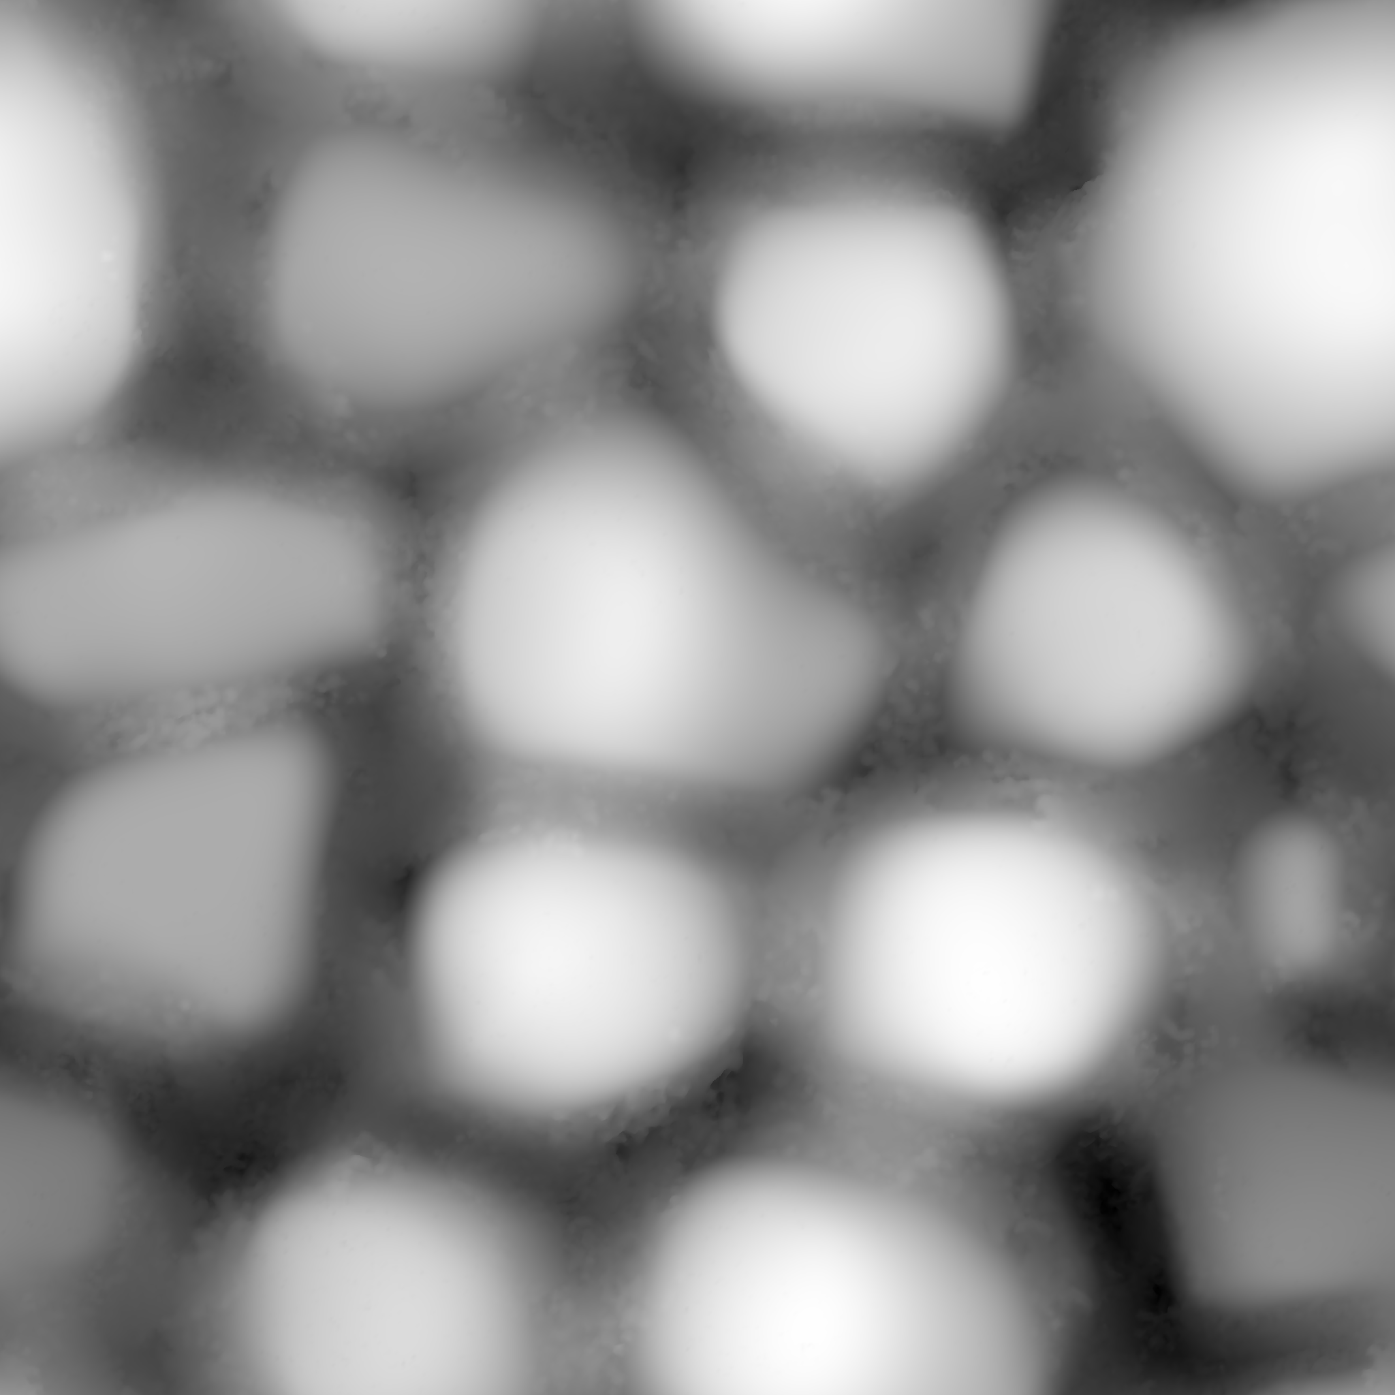
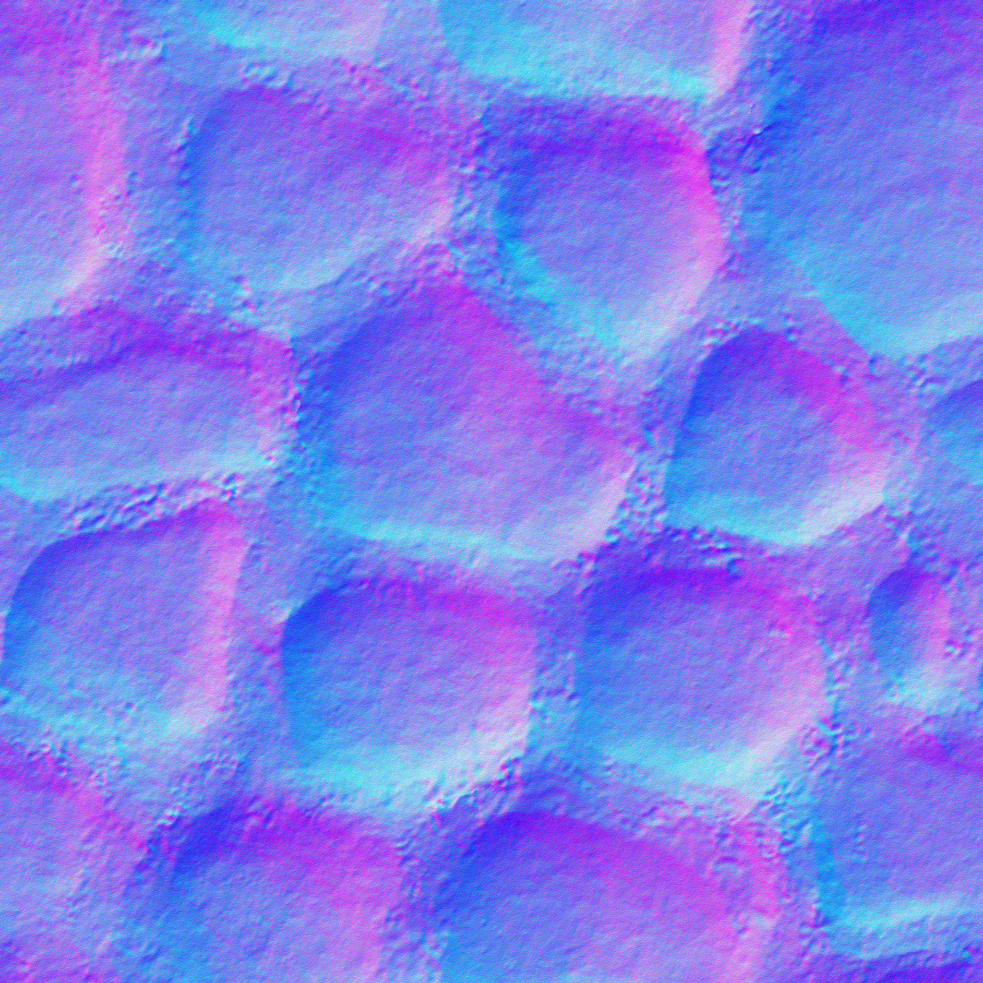
Height Map, Normal Map
Y 값만 바꾸는 것
(x, y, z) 로서, 어디를 바라보고 있는가?

Slide 8
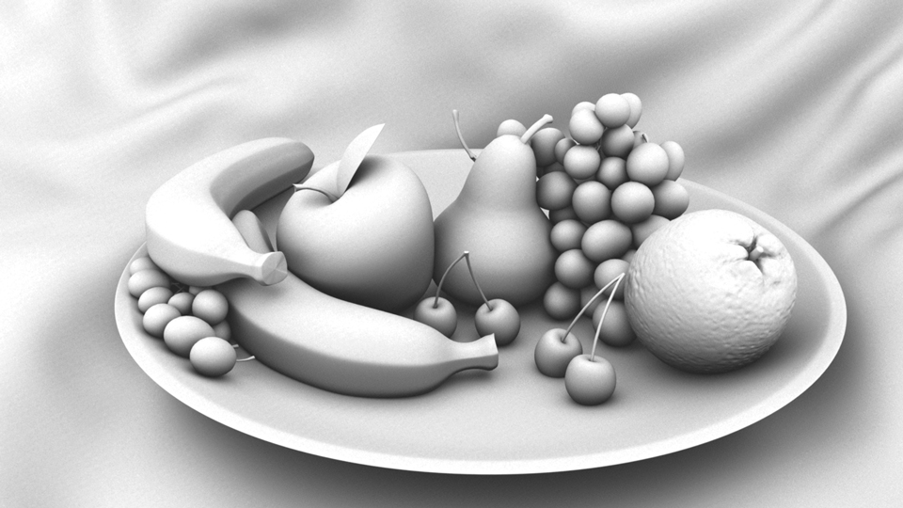
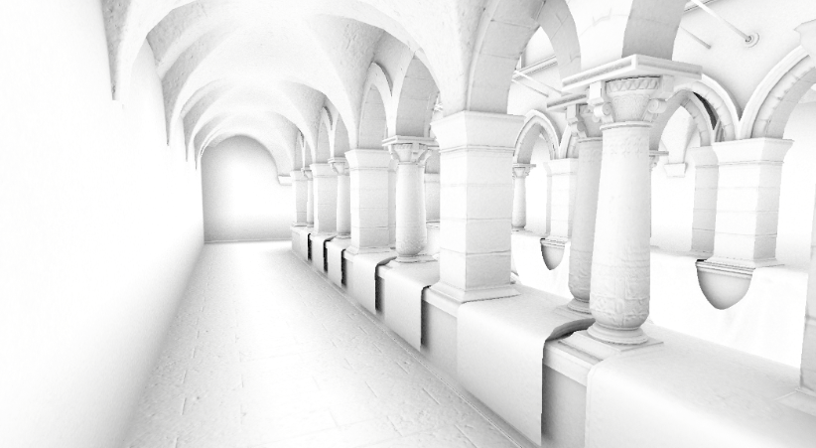
Ambient Occlusion
빛은 어디를 더 튕길까?
현실성을 줄 수 있는 매우 빠른 trick!

Slide 9
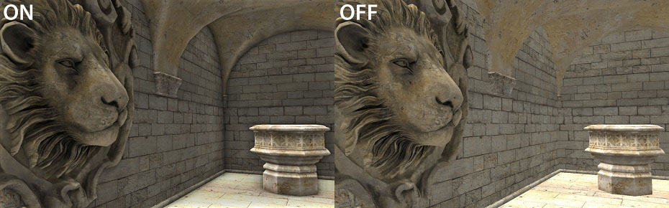

Slide 10
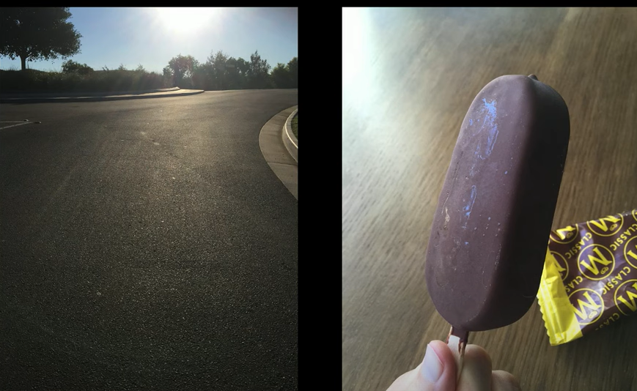
Variance

Slide 11
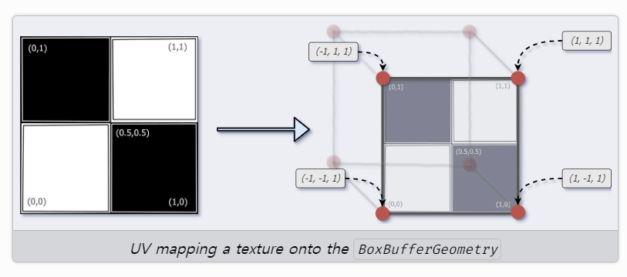
UV Mapping

Slide 12
Check the code!
Ref :
https://github.com/mrdoob/three.js/blob/master/examples/webgl_materials_standard.html
Yes check the examples!

Slide 13
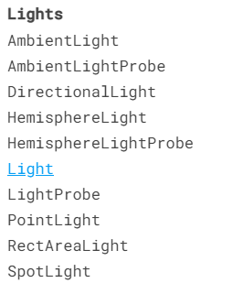
Lights in Threejs
Various lights in threejs. Check the docs.
+ Let’s check the codes

Slide 14
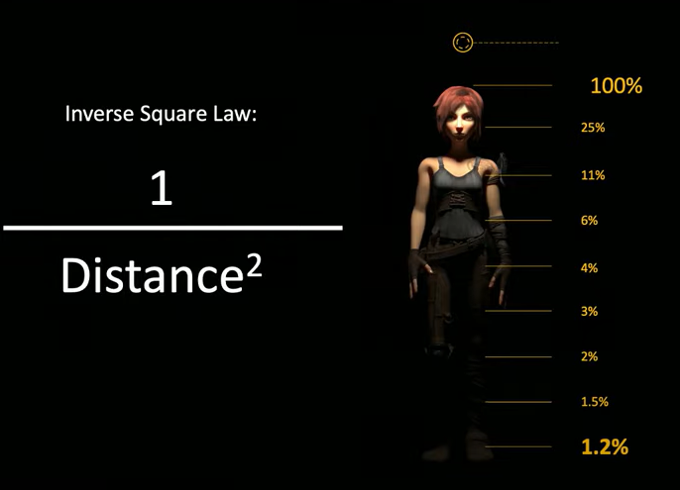
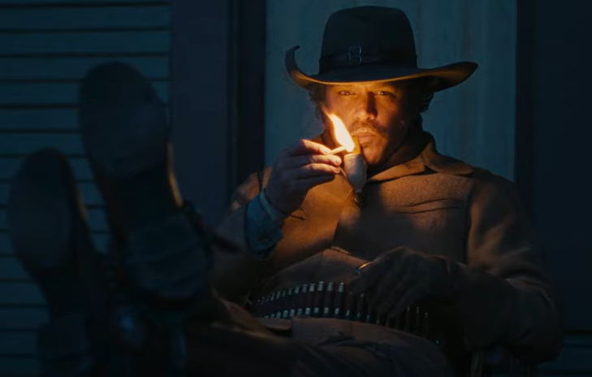
Secret about lights. “Falloffs”

Slide 15
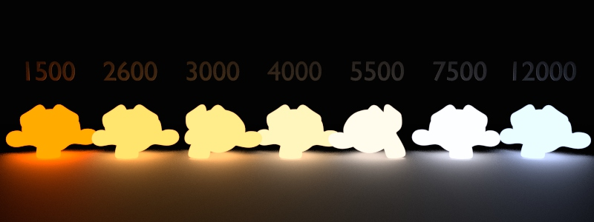
Secret about lights : Blackbody
https://threejs.org/docs/#examples/en/math/Lut
“Real life lights are blackbody-colored”

Slide 16
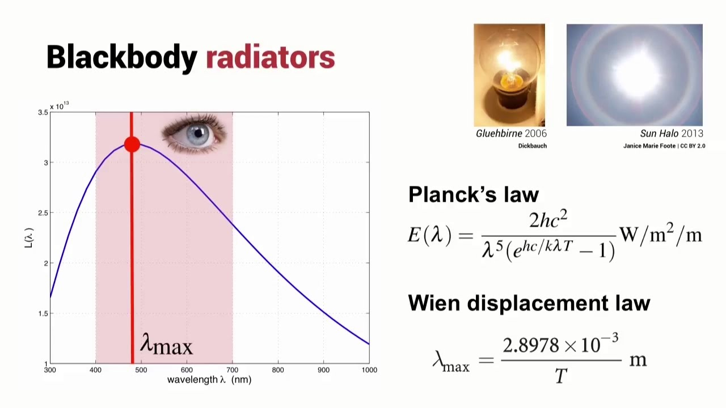
…

Slide 17
Camera Control

Slide 18
Load Complex Objects
Threejs officially recommends glTF format (GL Transmission Format)
https://threejs.org/docs/#manual/en/introduction/Loading-3D-models

